Slide 1

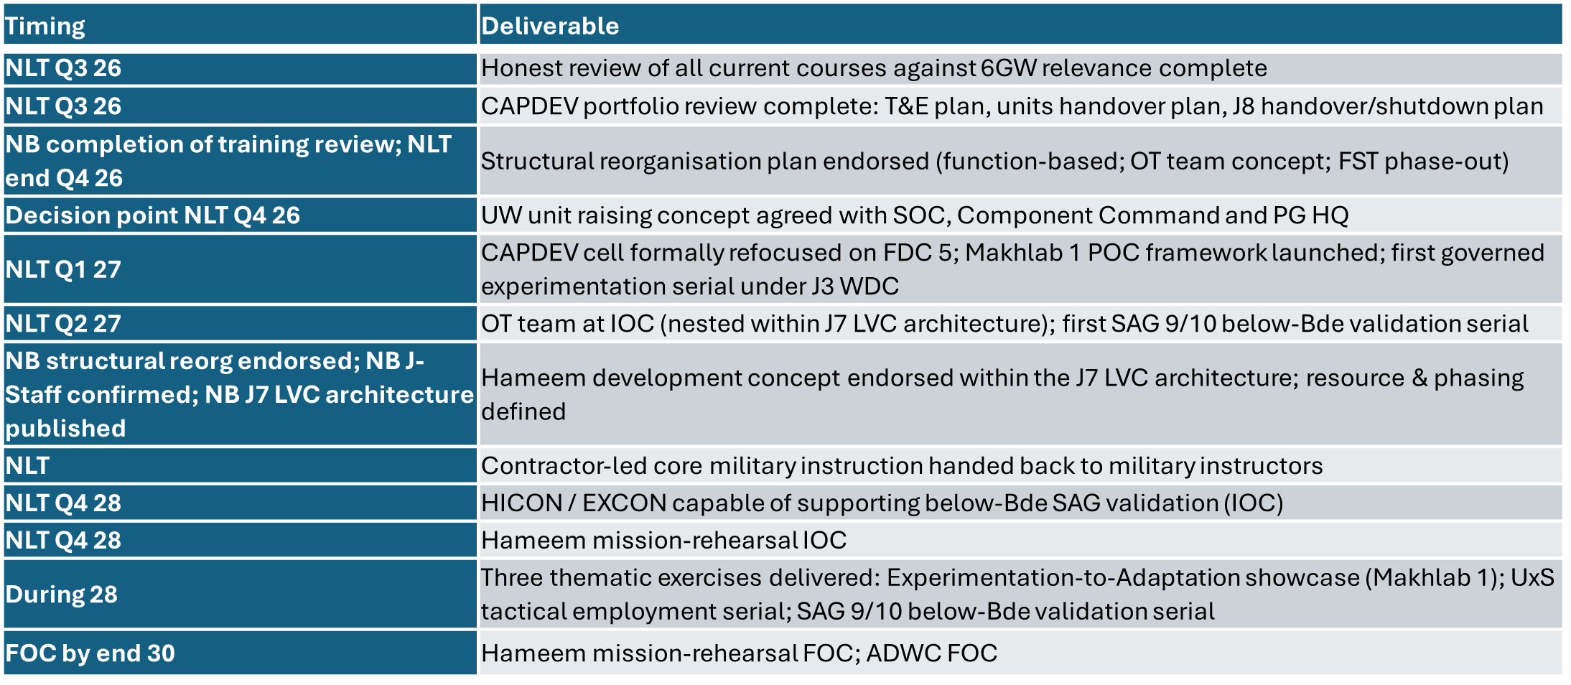
SBTDWS
SBTDWS will extend its scope from training PG force elements to operate in the desert environment to enabling them to prosecute All Domain Warfare. This will focus on training and validating PG units’ ability to conduct effective operations which synchronise effects in all 6 domains - to ensure they are capable of successfully waging Sixth generation Warfare (6GW). To reflect this expanded remit, SBTDWS will be referred to as the PG ‘All Domain Warfare Centre’ (ADWC) by 2030.
GAPS: PG HQ to establish or formally allocate J-Staff support to SBTDWS to enable ADWC functions. SBTDWS to develop the concept and raising plan for the future PG UW unit, in coordination with SOC handover and Component Command, decision point NLT Q4 26. J7 to lead, with SBTDWS, the development of an OT capability nested within the PG LVC training architecture, IOC NLT Q2 27. SBTDWS to develop a HICON/EXCON capability nested within J7's LVC architecture, capable of supporting below-Bde SAG validation by Q4 28. J3 WDC to establish experimentation governance and methodology for SBTDWS tactical experimentation under FDC 5; first governed serial NLT Q1 27. SBTDWS to develop the Makhlab 1 Proof of Concept framework as the operating model for FDC 5. All-domain training enablers (digital spine). Cyber, EMS, and digital integration overlays are wholly dependent on the J6 Digital Backbone (C4I, digital spine, organisational digitisation). These cannot be self-generated by SBTDWS. | LINKAGES: J7. SBTDWS's OT, HICON, EXCON and Hameem mission-rehearsal builds must all nest within J7's LVC architecture. Multiple efficiency opportunities — shared scenario design, common HICON/EXCON tooling, common OT standards, shared instrumentation, and a unified PG certification ladder from sub-unit to JTF. J3 Warfare Development Centre. All SBTDWS tactical experimentation triggered by — and governed under — J3 WDC. ADWC becomes the field execution arm; J3 WDC owns the doctrinal feedback loop. Avoids duplication and gives experimentation authority. PGI (IWTC). SBTDWS and PGI's IWTC together own Raise / Train / Sustain / Validate for SAG 9 (UW) and SAG 10 (R&CB). Working split: PGI delivers individual training; SBTDWS delivers collective training and validation. Operational C2 sits with the relevant PG Component Command. This split offers a single, coherent doctrine-to-validation pathway. Science and Technology Centre (STC) / Innovation Command. Strong habitual relationship for innovation and T&E. STC will fold into the future Innovation Command when stood up; until that point SBTDWS retains the relationship via FDC 5 / Makhlab 1. Not co-located at Hameem. PG Units. SBTDWS holds SAG 9 & 10 SRO and must train forces operating alongside or in support of all PG units holding IW/UW or R&CB tasks. Shared exercises, shared training areas, aligned standards — mirrors the AF/HBE shared-enabler model cited in the example. Mission exploitation lessons, deployment-readiness gaps and unit training needs as routine inputs into SBTDWS programme design.
DEPENDENCIES: J7 LVC architecture. SBTDWS's OT, HICON, EXCON and Hameem mission-rehearsal builds are wholly dependent on J7 establishing and leading the PG LVC training model. Without this, SBTDWS cannot nest its capability builds coherently and risks duplicative or non-interoperable infrastructure. J6 Digital Backbone. All-domain training overlays (cyber, space, EMS), C4I integration, organisational digitisation and any LVC connectivity at Hameem depend on the J6 Digital Backbone. J3 WDC stand-up & governance. FDC 5 experimentation depends on a functioning WDC providing the governance framework, trigger mechanism and feedback loop. Makhlab 1 POC framework is the SBTDWS operating model nested under WDC governance. PG HQ J-Staff support decision. Whether SBTDWS gains organic J-Staff or receives allocated support is a structural dependency that gates every other LOE. SAG 9 / SAG 10 standards endorsement. Validation is only meaningful if conducted against command-endorsed standards with reporting authority. SBTDWS depends on Higher HQ / Readiness Governance to define and authorise these. PGI / IWTC course alignment. Validation pathway depends on PGI delivering the individual training element to a standard SBTDWS can build on collectively. Innovation Command stand-up (timing). STC's eventual fold-in to Innovation Command will affect the long-term governance of the SBTDWS–STC habitual relationship. SBTDWS needs visibility on this timing to plan accordingly. Hameem capital funding & approvals. Infrastructure investment exceeds SBTDWS budget authority — depends on PG-level capital planning, with J7 as the LVC architectural authority. | KEY TIMINGS, MILESTONES & DELIVERABLES:
COMMENTS/ ISSUES/ CONCERNS: Pl(-) IW capability vs UW capability — clarification required. Each unit is being directed to grow a Pl(-) IW capability. Working assumption is that this is separate from the UW capability being handed off from SOC, but this needs explicit clarification from Higher HQ. The split has direct implications for SBTDWS's RTSV responsibilities and for what PGI's IWTC delivers at the individual level. The "All Domain Warfare Centre" name creates an expectation gap. SBTDWS has access to land and air only in the near term. Cyber, EMS, space remain dependent on J6 Digital Backbone. Recommend a name that does not promise what we cannot yet deliver. Direction is flexible — use that wisely. SBTDWS should not over-commit to deliverables it cannot resource. Summer / Ramadan windows are an opportunity. Repurposable for instructor development, simulation, planning and experimentation prep — quick win, no new resources. SBTDWS holds a single point of failure. SAG 9 & 10 SRO, the UW unit raising mission, FDC 5 Tactical Experimentation lead, and Hameem LVC site delivery all sit on one unit. Under-resourcing puts all of these at risk simultaneously.

Slide 2
SBTDWS TRANSFORMATION TIMELINE
CURRENT SBTDWS FOCUS
Desert Warfare Training Centre
SRO TASKS:
SAG 9. Combined Unconventional Warfare
SAG 10. Resilience & Capacity Building
FDC 5. Tactical Experimentation
PG2030 ADWC* FOCUS
PG All Domain Warfare Centre* – Training PG Operational Art
2026 Foundations |  | 2026 Decisions | 2027 Build | 2027 Endorse | 2028 Demonstrate | 2029 – 2030 FOC
Q2 | Q3 | Q4 | H1 | H2
Course review complete – Q3 26
LOE 1: FOUNDATIONS
Course review begins
Contractor HOTO* – NLT Q4 27
Standards & Assessment prog launch
Instructor Development Programme - Continuous
LOE 2: STRUCTURE
Structural Reog endorsed – NLT Q4 26
OT Team IOC – Q2 27 (in J7 LVC)
HICON / EXCON IOC – Q4 28
ADWC FOC – Q4 30
J Staff decision – PG HQ
LOE 3: VALIDATE & RAISE
LOE 4: EXPERIMENT & REHEARSE
UW UE concept – Q4 26
First below Bde validation serial – Q2 27
SAG 9/10 validation serial
Validation cadence FOC
OT trained to endorsed SAG 9/10 standards
Continuous validation cycle – PGI (IWTC) partner – Component Command customer
CAPDEV portfolio review – Q3 26
Makhlab 1 launch – 1st FDC 5 serial – Q1 27
Makhlab 1 showcase + UxS exercise
Hameem FOC – Q4 30
Hameem dev concept endorsed– Q1 27
Hameem Mission Rehearsal IOC – Q4 28
STC / Innovation Command – J3 WDC governance – J7 LVC achitecture
Minimum Limited Operating Capability (MLOC)
Initial Operating Capability (IOC)
Full Operating Capability (FOC)

Slide 3
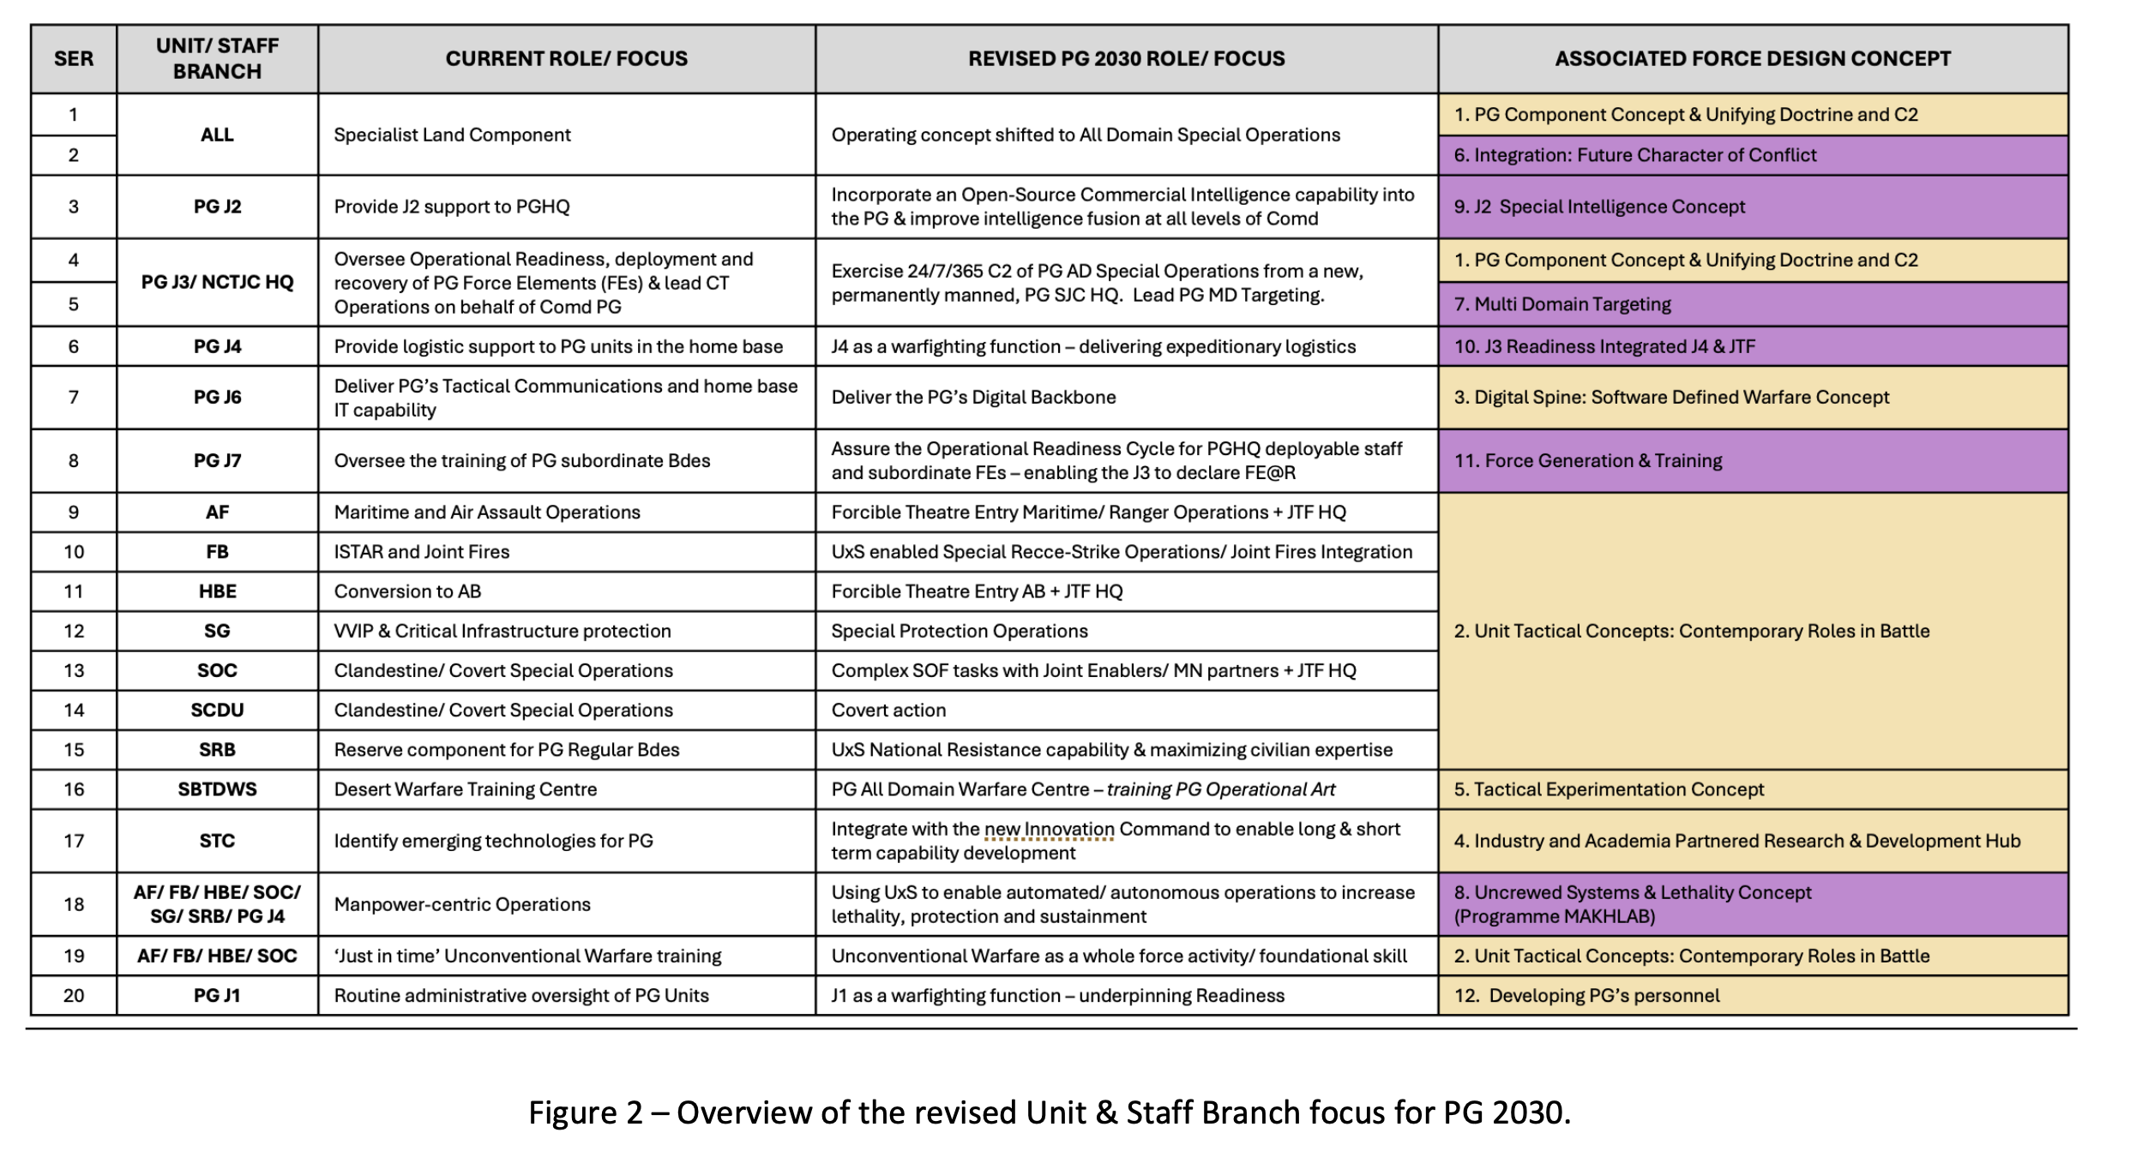

Slide 4
